Slide 1
Multidimensional Arrays on the Stack (Compile-Time)

Slide 2
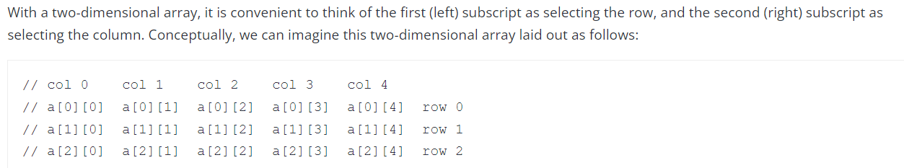
Multidimensional Arrays

Slide 3
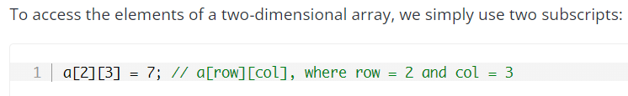
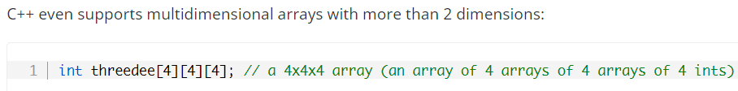
Multidimensional Arrays

Slide 4
Multidimensional Arrays
We mentioned that 1D arrays are laid out sequentially in memory (contiguous elements).
For 2D arrays, the elements are arranged in a row-major order.
Good to know because when accessing them, your outer loop can iterate over rows, and inner loop can iterate over columns.

Slide 5
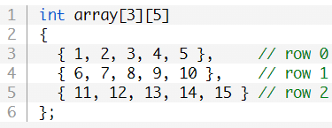
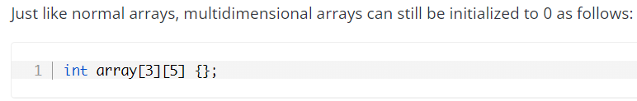
Multidimensional Arrays

Slide 6
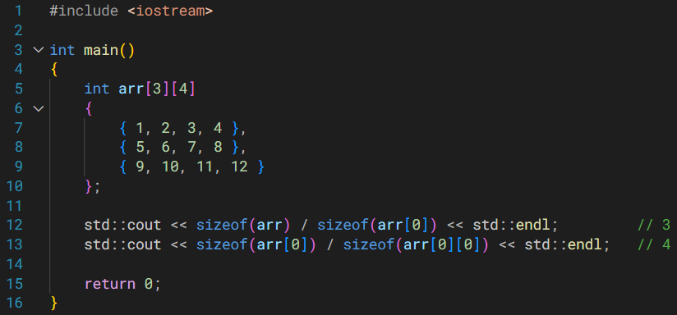
Multidimensional Arrays

Slide 7
Multidimensional Arrays on the Heap (Runtime)
You can now get varying number of columns in each row.
This wasn’t possible with the nD-arrays on the stack.

Slide 8
Varying Length of Rows
Creating 2D-arrays over the stack means that row lengths would always be constant.
If you need varying row lengths, you can allocate memory on the heap.

Slide 9
int** p{ new int*[4] }; // this creates the array of int*
p[i] = new int[len]; // this creates the ith array of int
Array of int*
int** p
Array of int
Array of int
Array of int
Array of int

Slide 10
Varying Length of Rows
Note that you first have to allocate the array of int*
Each element of this array can have an integer type address as its value.
So against each element of this int* array, we dynamically allocate an array of int
Recall that p[i] is identical to *(p + i)
Both of these will give you access to the data or the value stored at index i in the int* array.

Slide 11
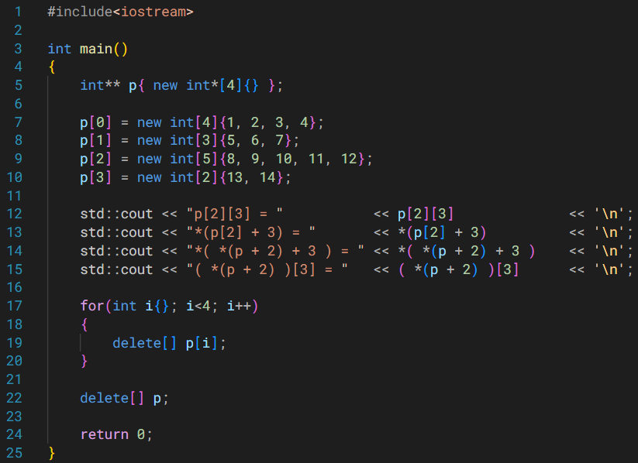


Slide 12
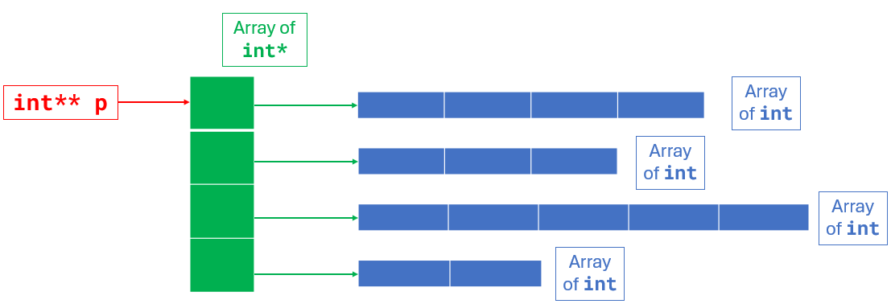
Figure out how to access the value and address for this element.
In order to access each element, you can treat this like a 2D array.
So to access the marked element, you first need to go to the correct row.
We can do that by, p[2] or *(p + 2) in this example.
Once we’re in the correct row, we need to get to the correct element (or correct column). Do that by,
p[2][3] /* easy to read; other ways are shown so that you understand what’s going on, and what can be done. */
*( p[2] + 3 )
*( *(p + 2) + 3 )
( *(p + 2) )[3]

Slide 14
Varying Length of Rows
All of the memory that you have taken from the heap must be manually deallocated using delete.

Slide 15
Note that this is already on the stack memory. So it will be automatically deallocated.
Then deallocate this pointer type array.
Array of int*
First these would be deallocated.
int** p
Array of int
Array of int
Array of int
Array of int

Slide 17
Varying Length of Rows
If you deallocate the int* array first, you will create a memory leak of all the int arrays.

